Slide 1
HEC-RAS. Terrain and mesh generation
Giulia Sofia, PhD

Slide 2
Overview
Projection
Creating a RAS Terrain Layer
Types of Terrain Models
Building a Terrain Model
Key Feature Considerations
Cell Size Considerations
Importing Terrain Information to RAS

Slide 3
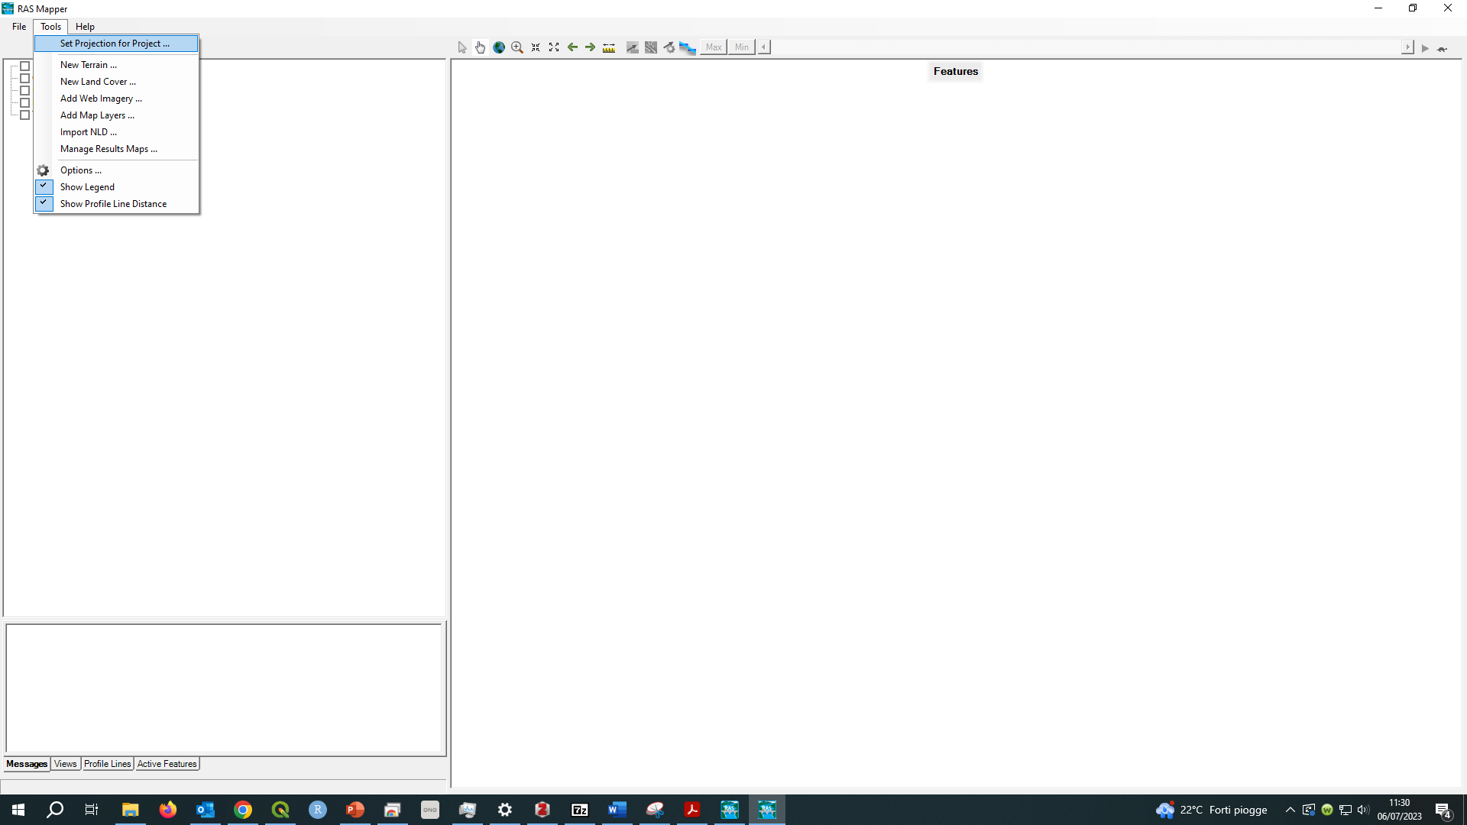
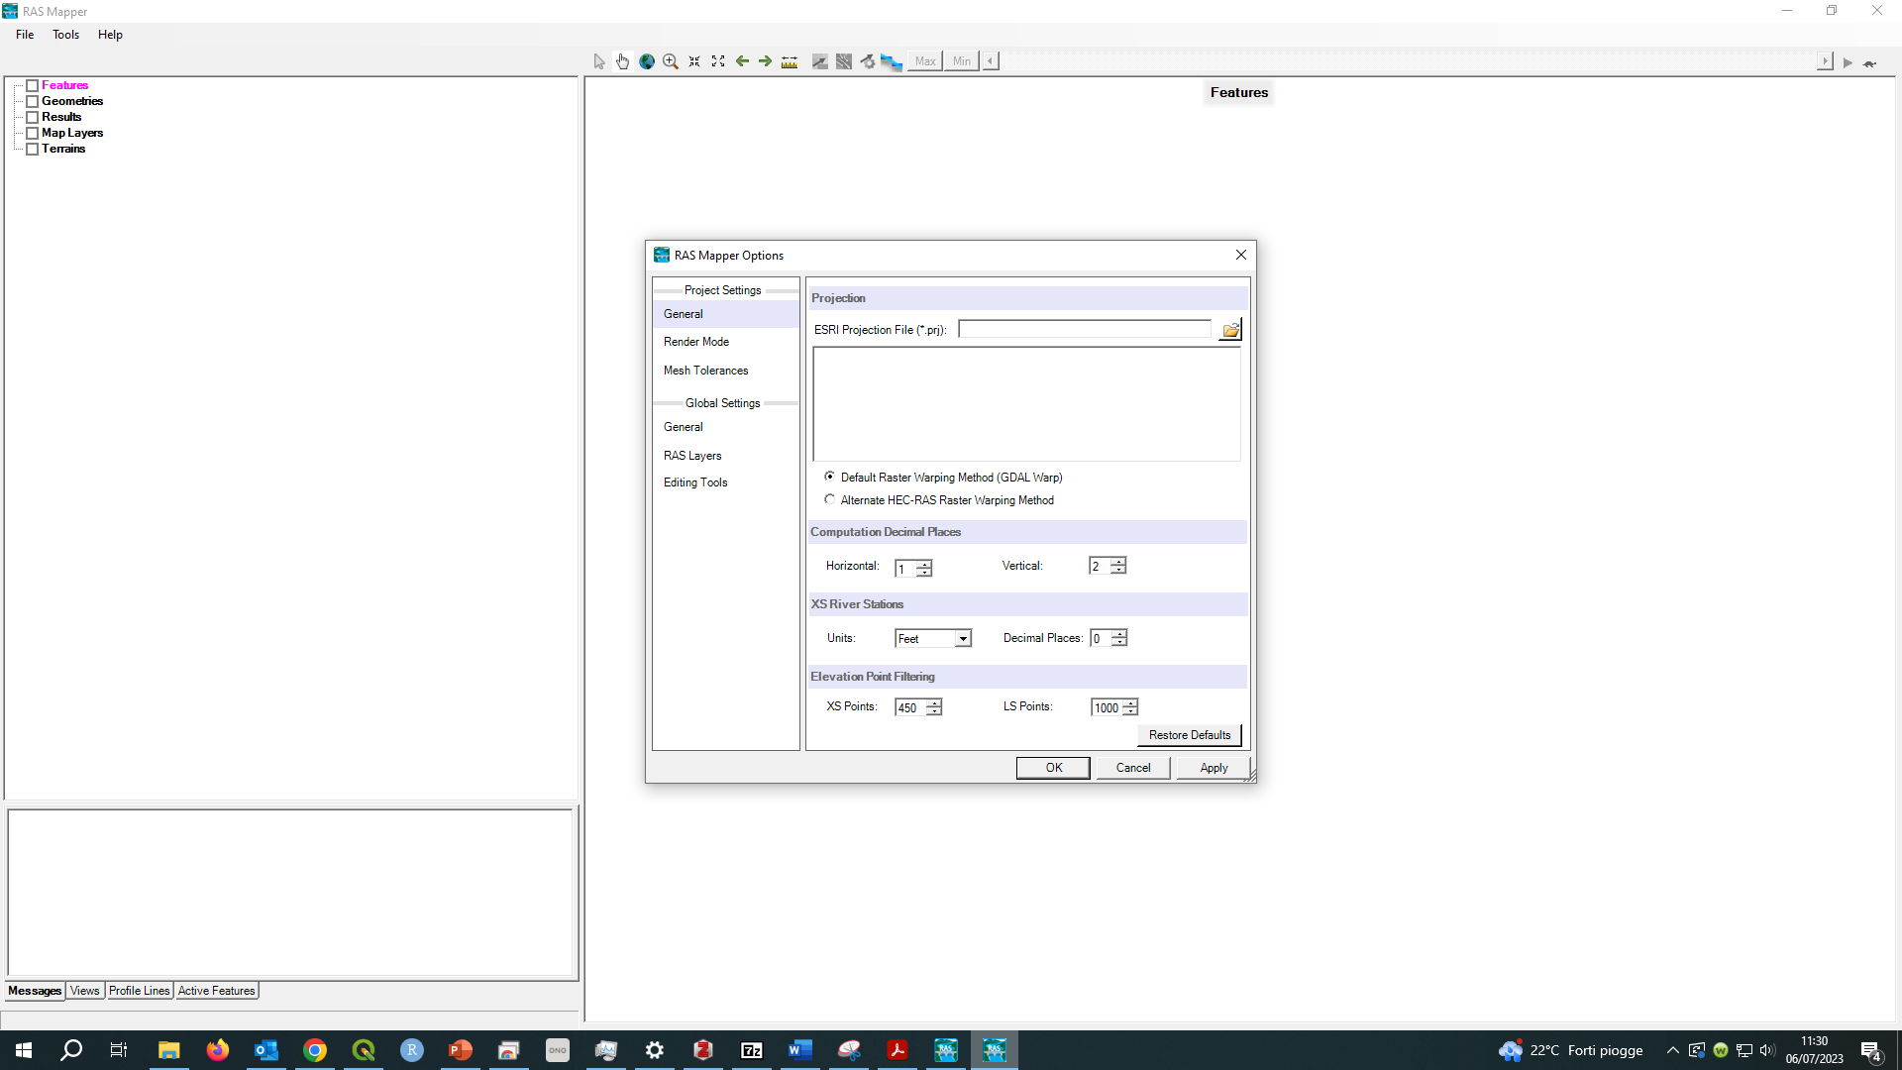
Overview
Projection
Data used in RAS Mapper must be a common coordinate system.
Projection will be used to re-project Terrain data that is imported intoRAS Mapper.
Defined using esri PRJ file.
Web Imagery will be projected on-the-fly to RAS Mapper coordinate system.

Slide 4

Projection
The Projection (Spatial Reference System) is defined in RAS using an ESRI well-known text PRJ file. Having this defined will allow you to export data to be used with other GIS layers and allow other GIS layers to be displayed with your data.
RAS Mapper has the ability to display Web Imagery. If the projection is correctly defined, the web imagery will be projected as a background map. Depending on the projection used for the data the web imagery labels may look great (using local projection) or not so great if you are using a national projection and your data is on the edge of projection limits.

Slide 5
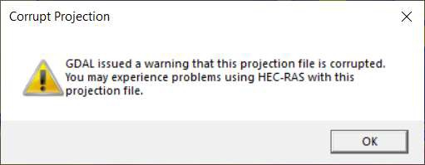
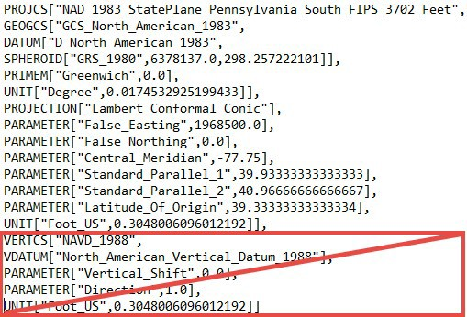
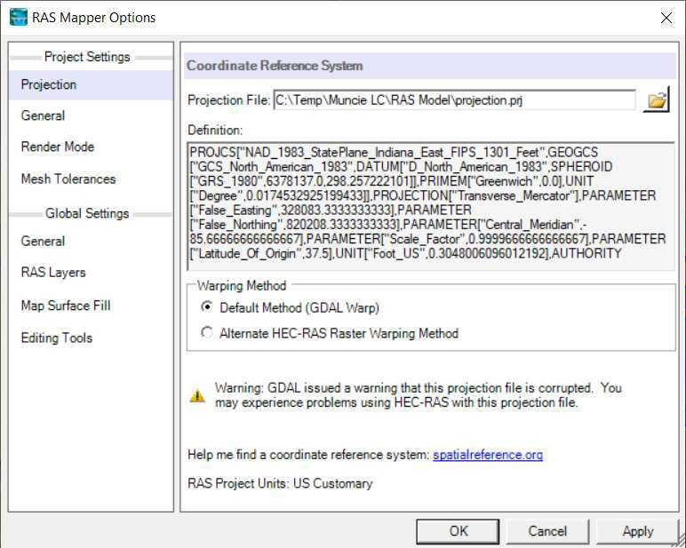
Projection
The “old” standard esri projection file is currently supported by HEC-RAS.
The newer standard that has the Vertical datum and units information is not supported.

Slide 6
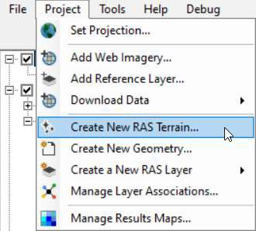
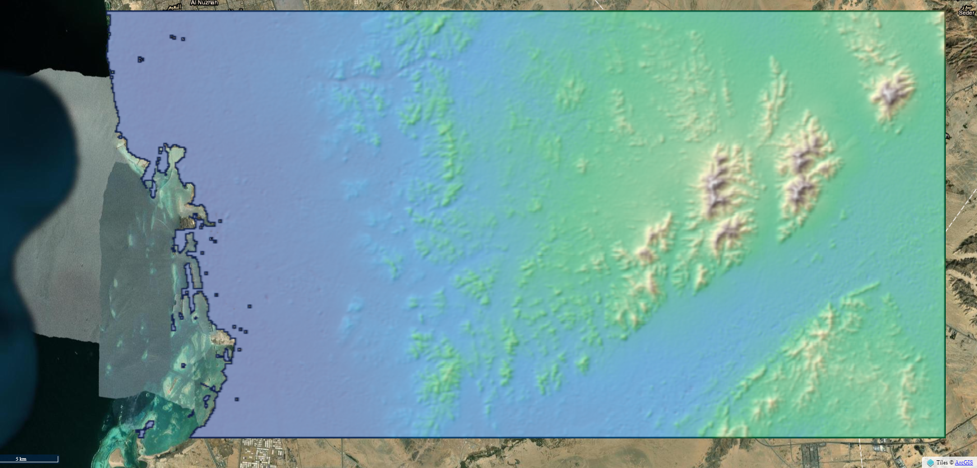
Terrain
A good model starts with good terrain …

Slide 7
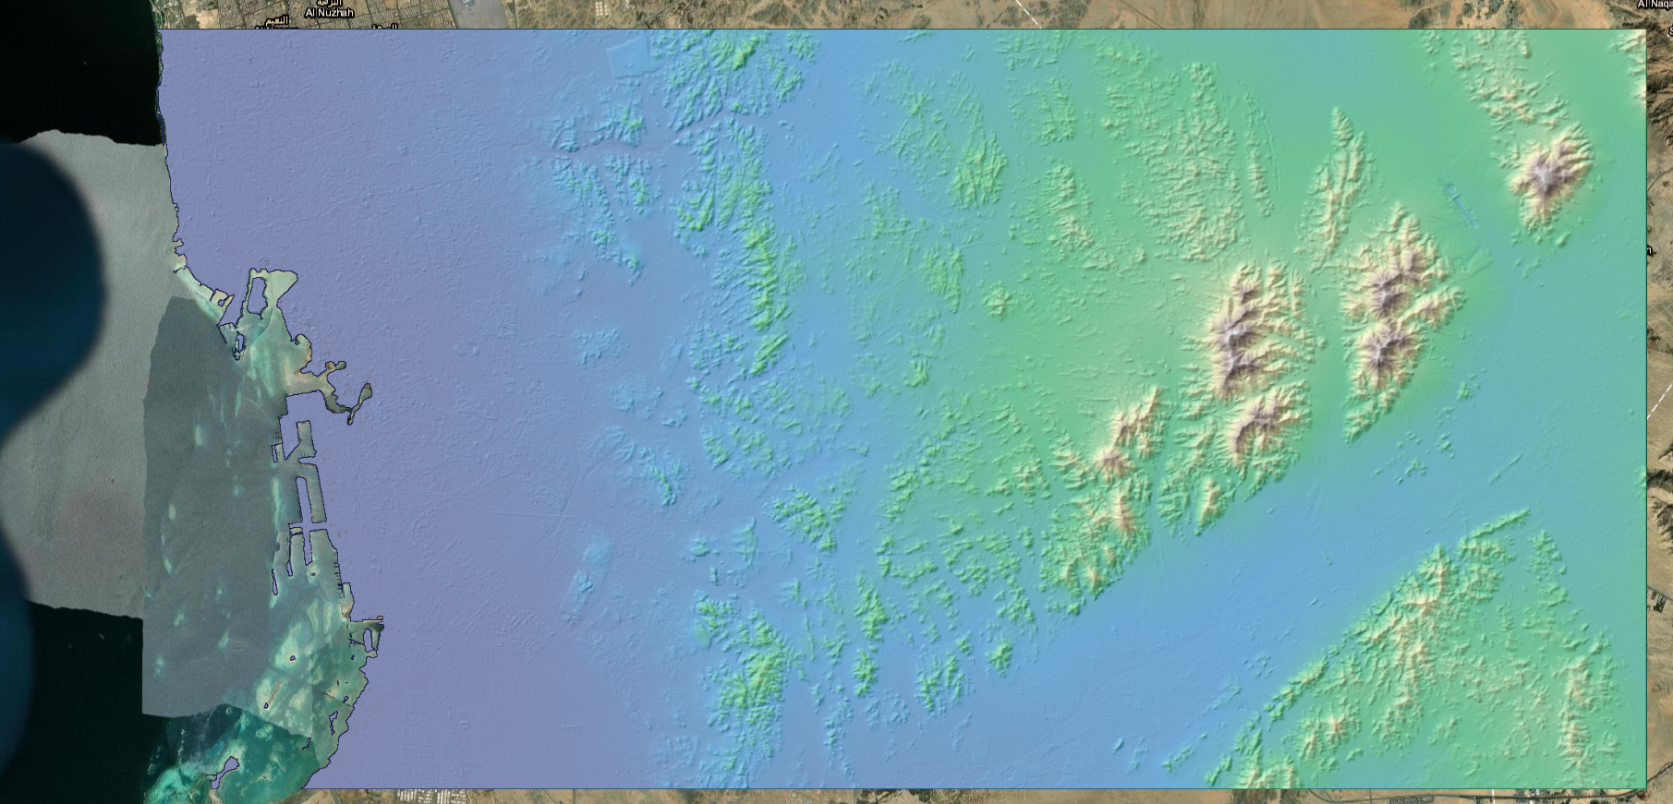
Terrain
A good model starts with good terrain …

Slide 8
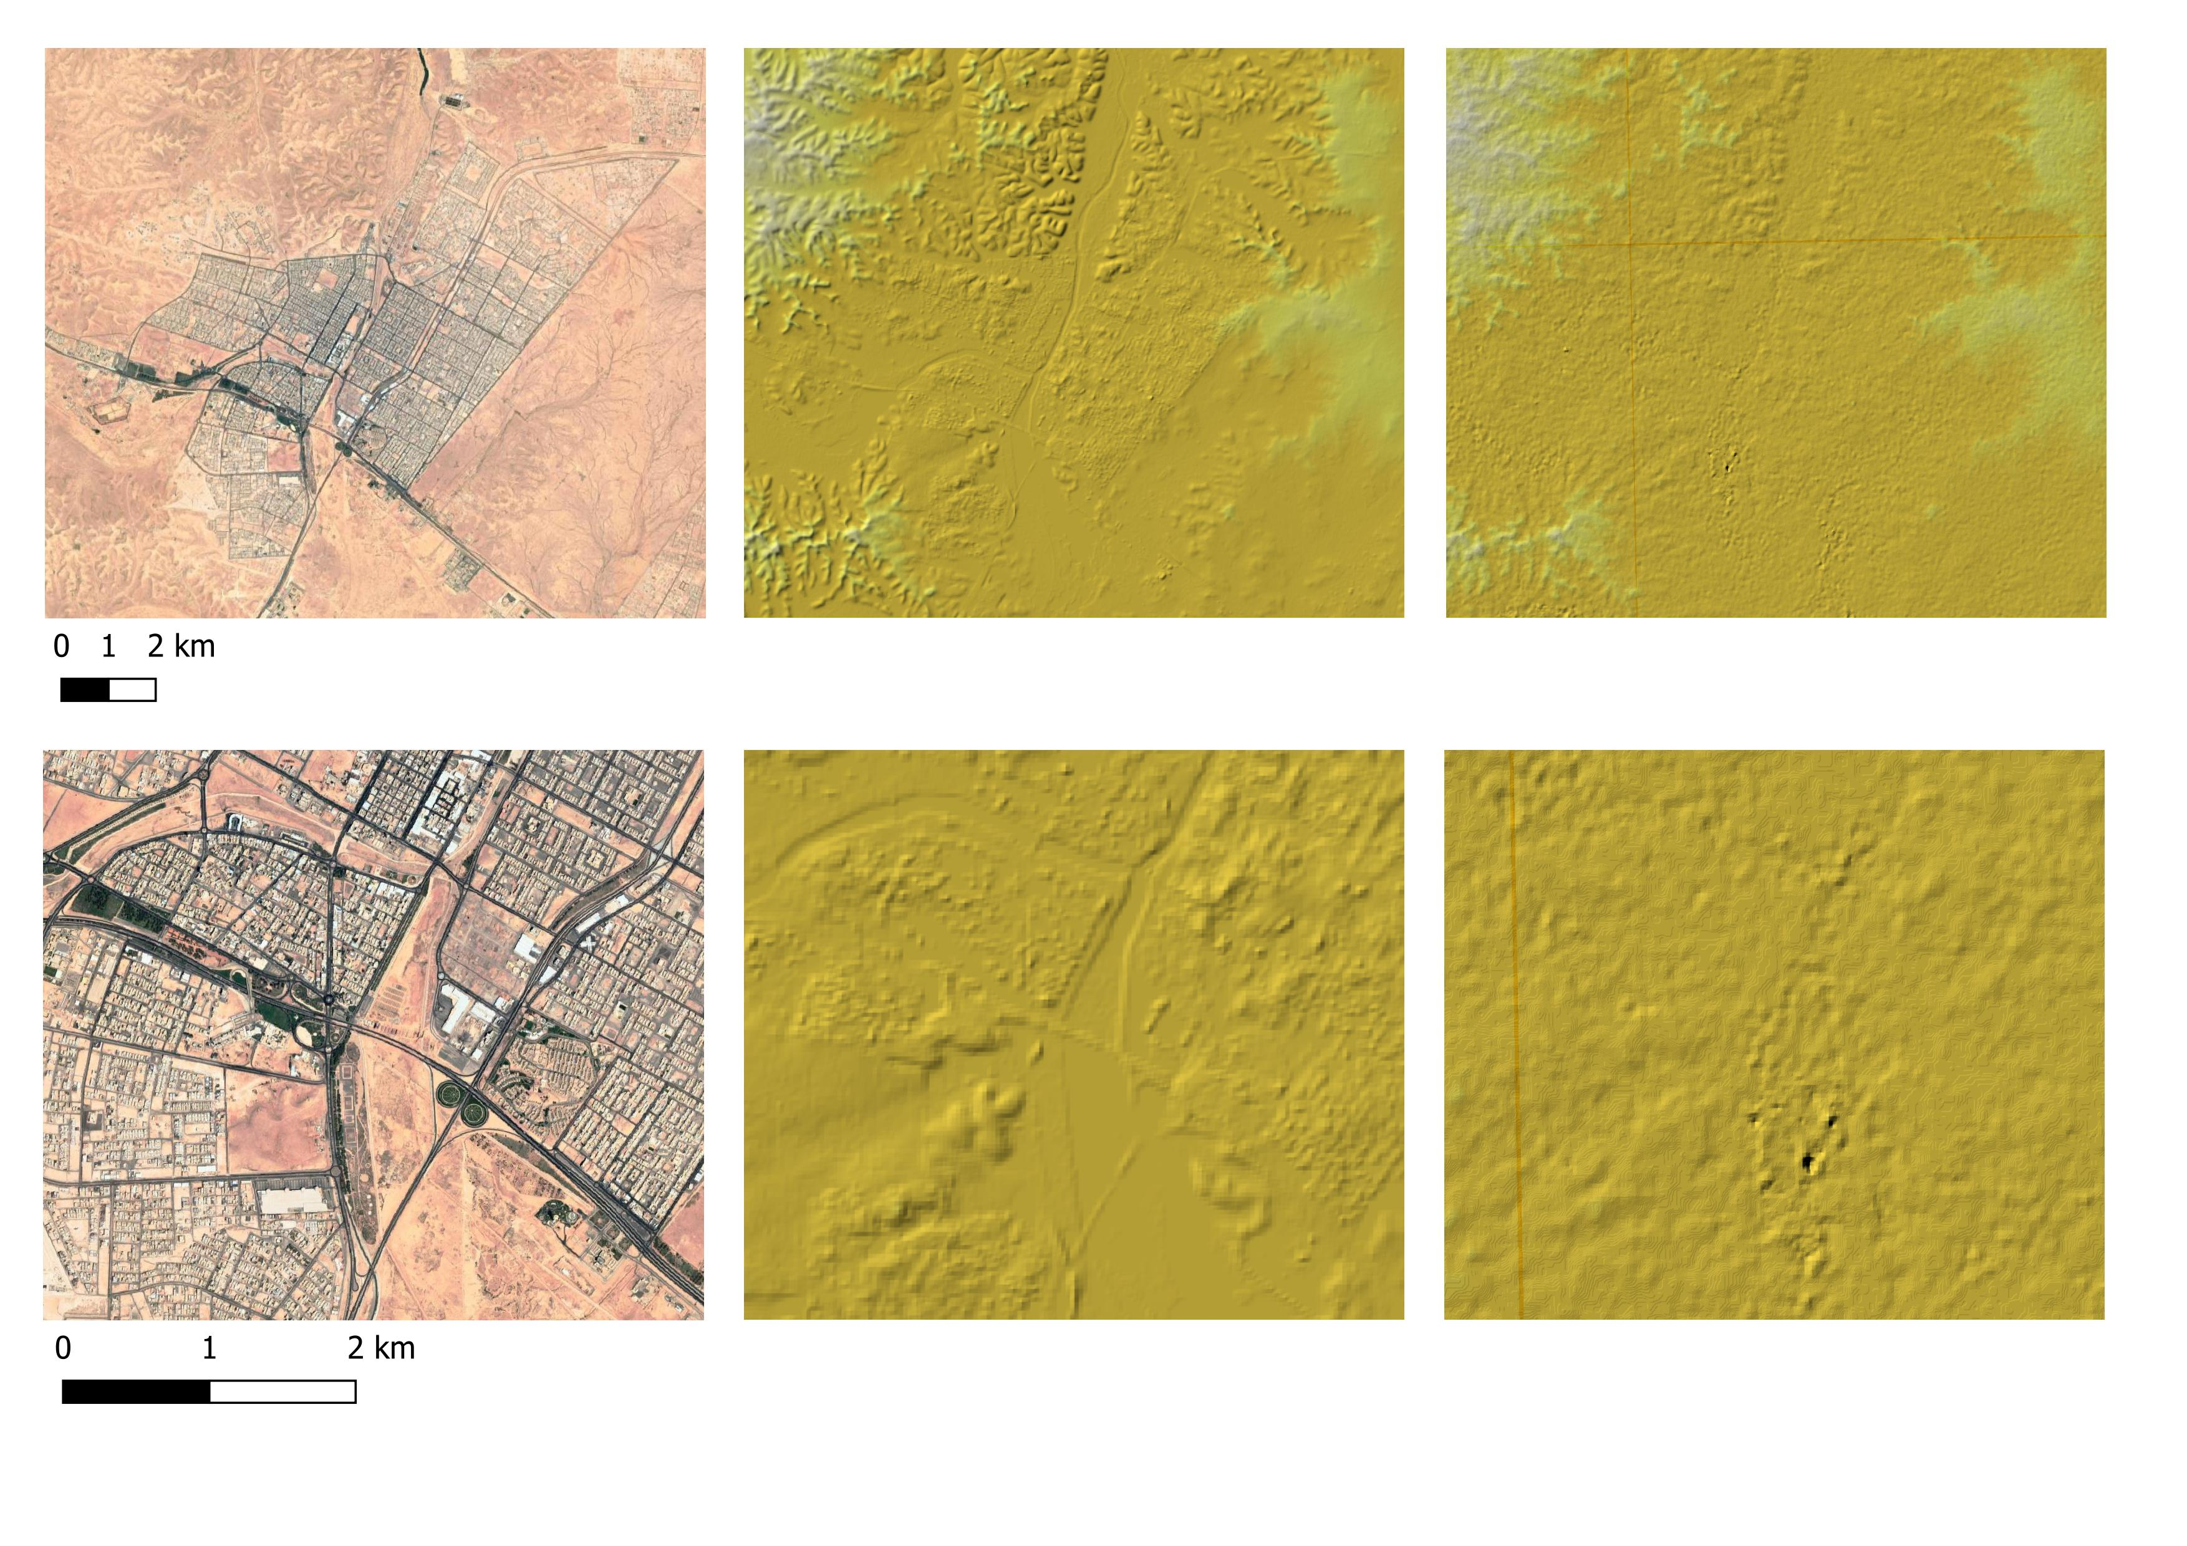
Terrain
The Copernicus DEM at the 30 m resolution is clearly a more accurate representation of surface than the other existing datasets, with comparable resolution.
Copernicus DEM [30m] SRTM [30m]

Slide 9
Terrain
Terrain Cell Size Considerations
Purpose and scale of model
Detailed analysis [urban area]
Typical riverine model
Small enough to represent the land surface accurately, NOT any smaller
Terrain model for 2D computations needs to accurately reflect features that direct flow
Align 2D cell faces with the controlling features

Slide 10
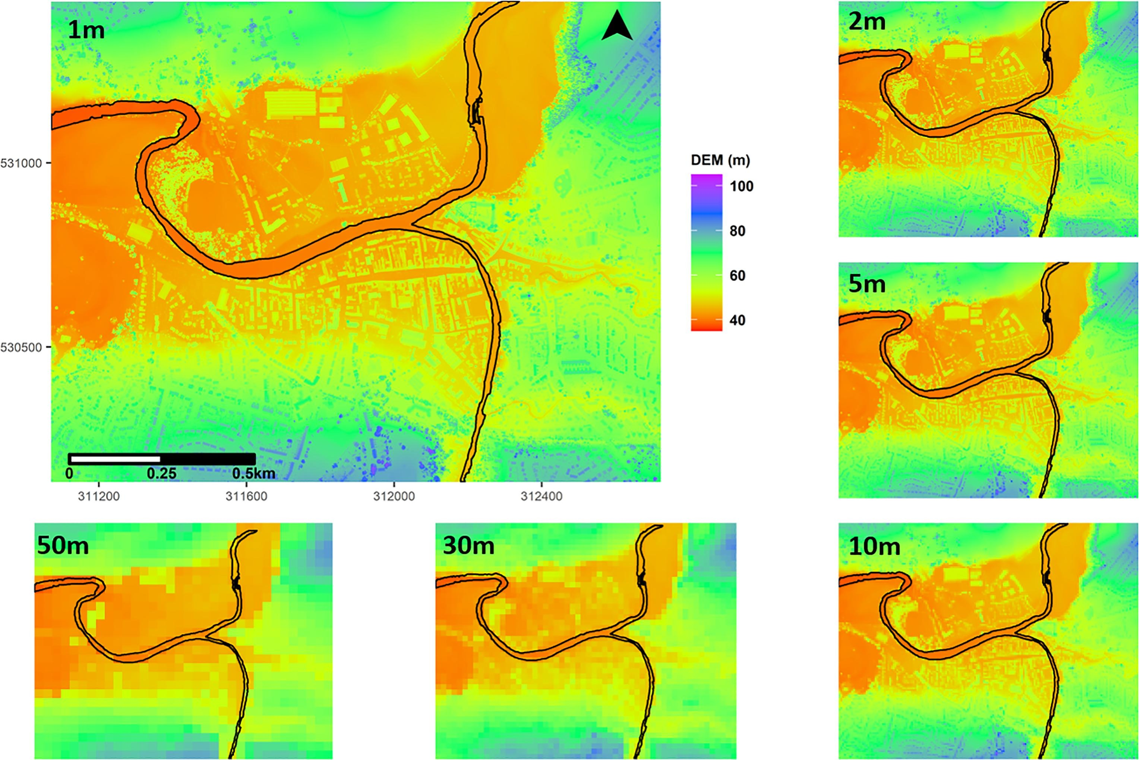
Terrain
Is it simply, “the higher the resolution the better”? What other considerations can tip the scales for or against the use of high resolution?
https://doi.org/10.1016/j.jhydrol.2021.126088
Notes:
Yet, although higher spatial resolution and accuracy often translate to improved results, these benefits cannot be considered in isolation, especially when we consider how numerical flood models work. Numerical models rely on multiple simulations to represent the physical processes of flooding and these simulations can number into the hundreds of thousands or more depending on an area’s extent. The more complex models are (i.e., the higher the spatial resolution), the greater the demands on computational power, processing time, file size, data storage and cost (Environmental Systems Research Institute, Inc., 2016). On the other hand, using comparatively lower resolution data means lower feature spatial accuracy but faster processing and smaller file sizes. Thus, depending on a client's objectives and requirements, lower resolution may fit the bill.

Slide 11
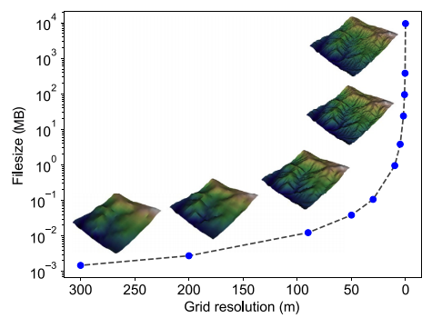
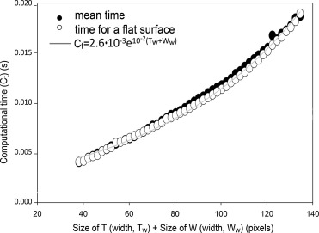
Terrain
Grieve et al. 2020 Developments in Earth Surface Processes
Sofia et al. 2014 ISPRS Journal of Photogrammetry and Remote Sensing
Numerical models rely on multiple simulations to represent the physical processes of flooding and these simulations can number into the hundreds of thousands or more depending on an area’s extent. The more complex models are (i.e., the higher the spatial resolution), the greater the demands on computational power, processing time, file size, data storage and cost (Environmental Systems Research Institute, Inc., 2016). On the other hand, using comparatively lower resolution data means lower feature spatial accuracy but faster processing and smaller file sizes. Thus, depending on a client's objectives and requirements, lower resolution may fit the bill.

Slide 12
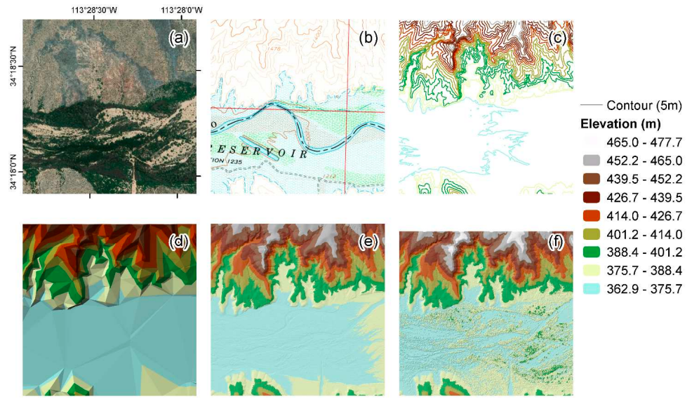
Terrain

Slide 13
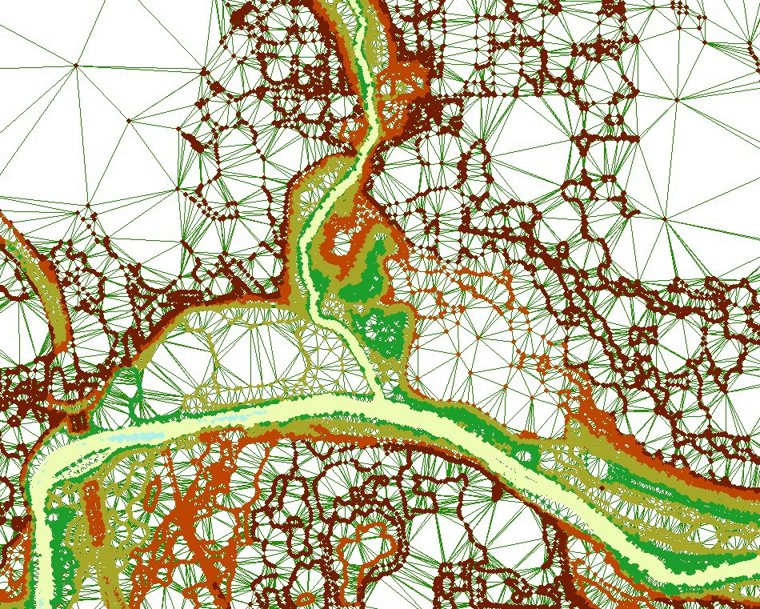
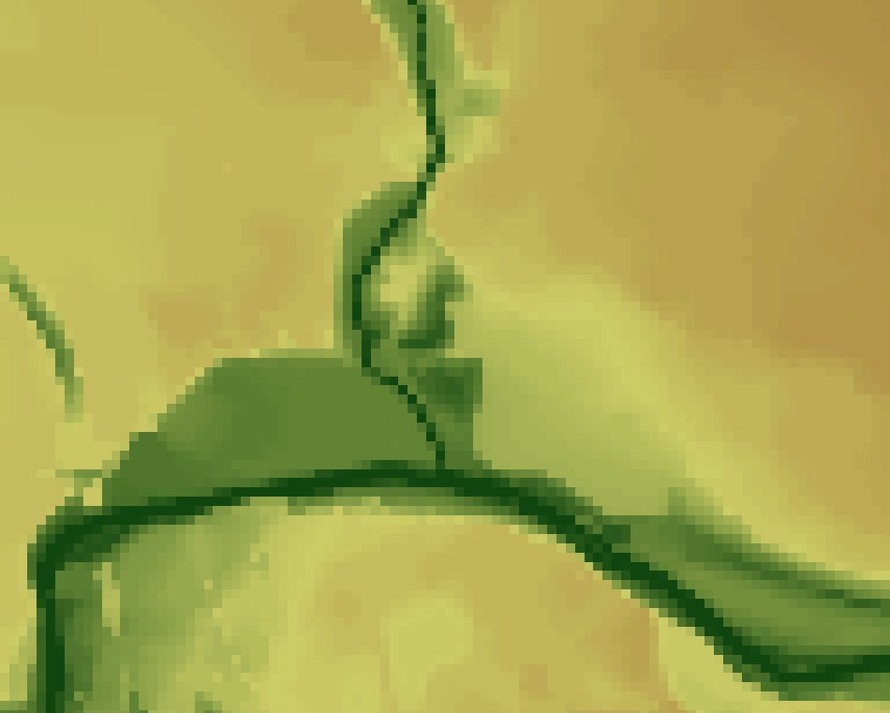
Terrain
Terrain models are stored as either TINs or Grids.
Triangulated Irregular Networks (TINs) are created by triangulating point data. TINs are the best way to represent a surface because they can represent linear features in the terrain using breaklines to enforce edges and elevations. In other words, you can densify information where elevations change rapidly (such as river banks or at levees).
All ground surface models start as a TIN.
Grids represent a surface using a single point over a generalized area, typically defined as a grid cell. Grids are efficient at storing information and for mathematical operations; however, they are a generalization of the original terrain surface. The smaller the grid cell size, the more accurate we might be able to make a terrain model, however that results in more data on disk and longer processing times.

Slide 14
Terrain
Building a Terrain Model Verify and Process Points
Remove of points that are not necessary/incorrect in representing the ground surface
Redundant points (more points = more processing)
Bridge deck elevations
Make sure to add important features
Top of roads
Top of levees
Top of floodwalls
Bridge approaches
Hydraulic structures
Replace over-water returns with bathymetric data [If possible!]
11

Slide 15
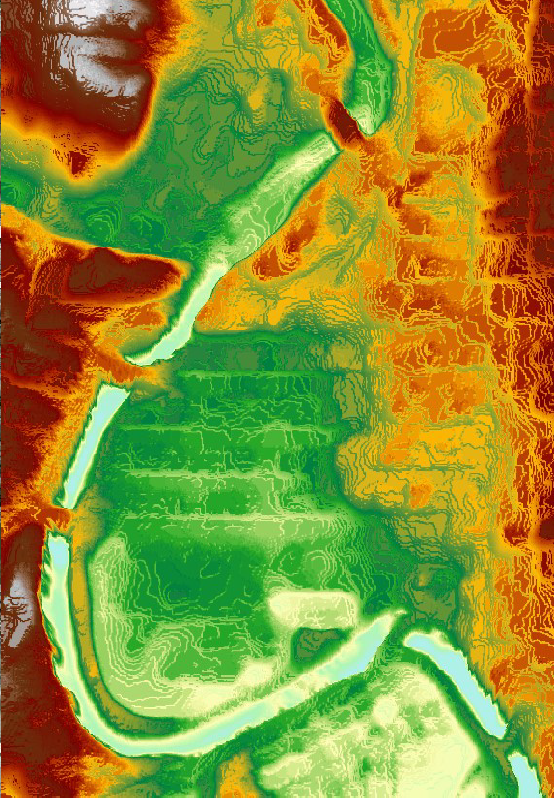
Terrain
Bridges
Removal of bridges from terrain data is important for 2D modeling.
High ground directs flow – determined directly from ground surface model.
1D modeling place cross sections at appropriate locations as work around.

Slide 16
Terrain in HECRAS
Terrain models are developed as TINs
Model is typically exported to a Grid for visualization and analysis
TINs are more difficult to render
TINs are more expensive to store
Calculations with TINs more difficult than with rasters
Grid-cell size determines the effective accuracy of the resulting terrain model
How are you going to represent a road/bridge/embankment in a raster with a 100 m grid cell?

Slide 17
Terrain in RasMapper
The file format that HEC-RAS has adopted for raster data is the GeoTiff file format.
This file format allows for efficient data storage and some benefits that assist in data visualization.
The data is compressed for smaller file size. Smaller file size means faster read/write times. (For example 46 tiles of 13GB compresses to 2.3GB)
Pyramids allow for fast visualization based on a particular zoom level. For instance, if you are zoomed out, there is no need to render the entire dataset, just a resample version that matches the number of pixels on your screen. Because RAS is only plotting the number of cell values corresponding to the number of pixels on the screen, RAS can use the pyramiding to do on-the-fly map generation. No need to store depth grids – just generate what the user wants.

Slide 18
Terrain in RasMapper
Various formats are supported
Binary Floating Point Raster (FLT)
Esri Arc/Info Grid format
GeoTIFF (still rounds and compresses)
Others (e.g. USGS DEM, etc)
Imported data is rounded to based on precision selected
Default is 1/32 (~0.03 ft) (1/128 for metric)
Recommended that a projection is defined for the RAS Mapper project first.

Slide 19
Terrain in NCM system
The analysis is performed using the TIN terrain embedded in the *.g01 file.
The results are re-interpolated considering the GRID file added as *.asc, at the resolution of the ascii file.
[This choice is done so that the libraries do not need any geospatial packet to process the outputs]
If the *.ASC file is not provided, the system downloads the Copernicus 30m DEM for the area, from the Copernicus API.

Slide 20
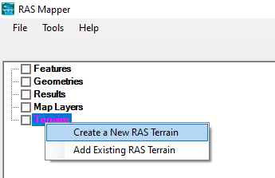
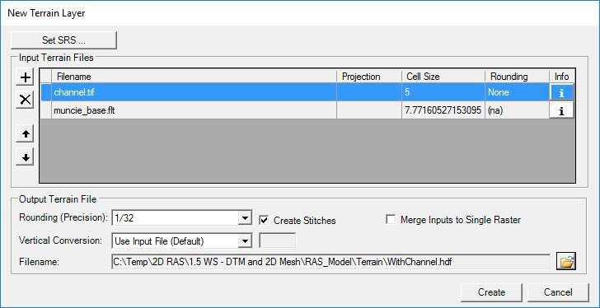
Terrain in RasMapper
Once a projection is defined, then you can Add a New Terrain. The Terrain will be created from input terrain models. This is how it works.
Add File of interest
You specify the Priority for using the terrain files (highest is most important).

Slide 21
Terrain in RasMapper
Once a projection is defined, then you can Add a New Terrain.
The Terrain will be created from input terrain models.
Decide on the Name and location to store the data and the name is used to create a GeoTIFF of each of the input files
Specify the Priority for using the terrain files (highest is most important).
Povide the Rounding Precision and as the GeoTIFF is built the data is rounded, compressed, and tiled.
The data is projected (if necessary)
A “Terrain.hdf” file is created that manages the data as one layer. Within Terrrain.hdf file there is also information which includes triangulation of the data across boundaries if multiple terrain models or holes in the data exist.
An output dialog provides the status of the GeoTIFF import process.

Slide 22
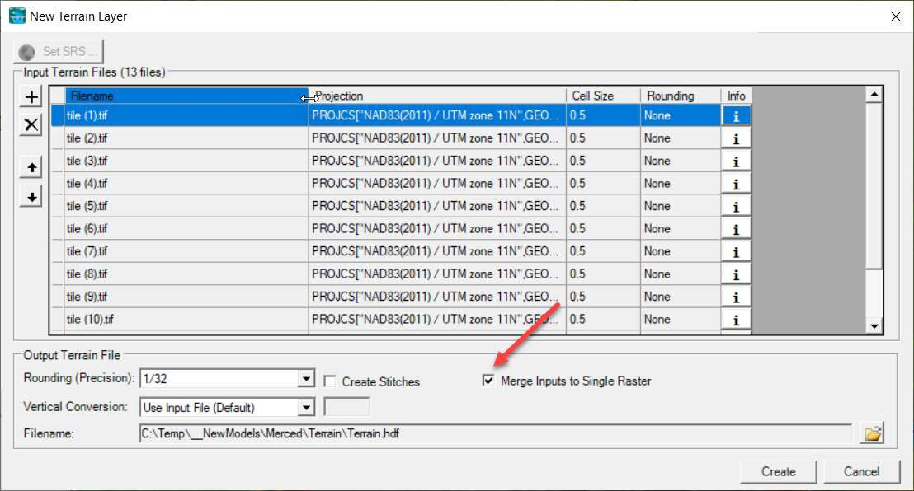
Terrain in RasMapper
Once a projection is defined, then you can Add a New Terrain.
If you have multiple files, you can allow HECRAS to merge them into a single terrain file
Note that the terrain is stored as HDF file. The Linux system, however, does NOT use this file at all, but rather reads the information directly from the computational mesh [that must be created AFTER the terrain import], stored in the .g01 file

Slide 23
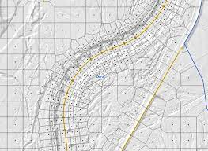
Mesh
Common Terms
How to Create a Mesh
Limitations
Fixing Mesh Problems
Hydraulic Property Tables

Slide 24
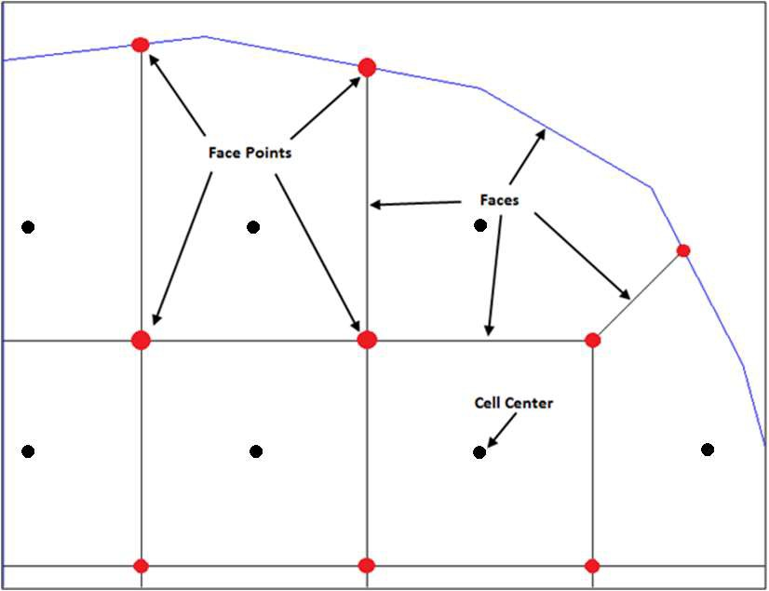
Common terms
Naming Convention
Cells
Face Points
Faces
Computation Points (center)

Slide 25
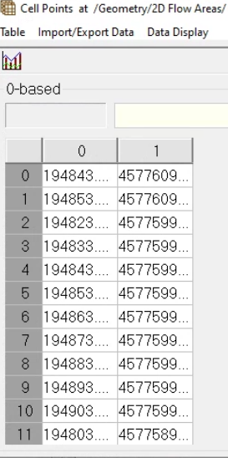
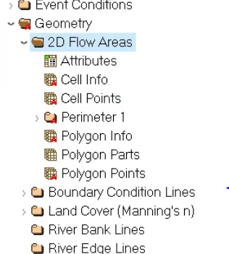
Common terms
This information is stored in the HDF files, under the ‘geometry’ umbrella
Importantly, the NCM system relies on the Cell Points to produce the final output on the HTML files

Slide 26
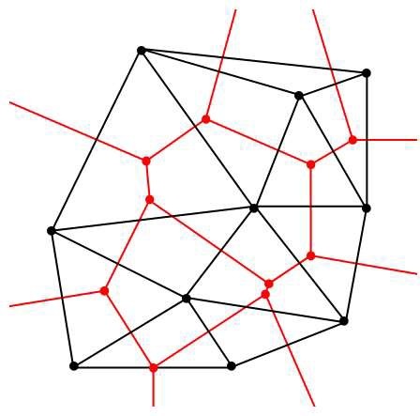
Mesh generation
Define mesh boundary and triangulate Computation Points (black dots)
Face Points (red dots) are triangle circumcircle centers
Faces (red lines) connect face points
Faces are also “Enforced” with internal breaklines

Slide 27
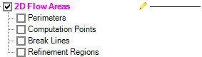
Mesh generation in RasMapper
Meshes are generated from a set of computation points with consideration to polygons and breaklines.
Steps/Features used to create a mesh:
Perimeter Polygon
Computation Points
Breaklines (Optional)
Refinement Regions (Optional)
Creating a good mesh is an iterative process!

Slide 28
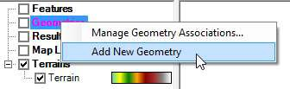
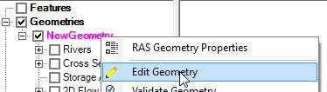
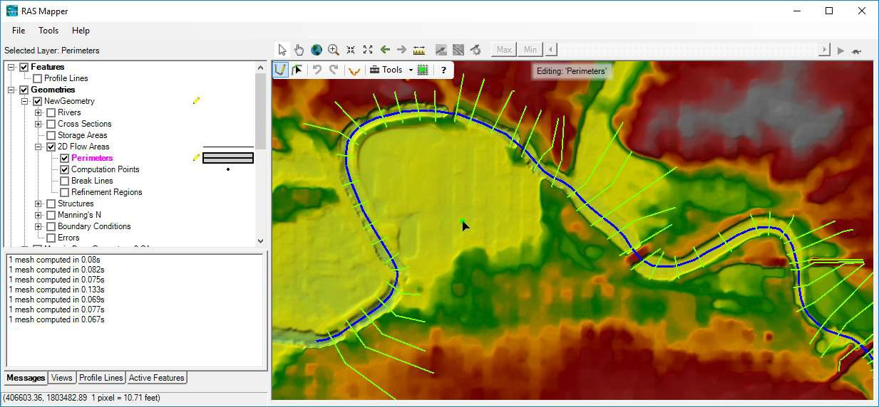
Editor Access
Create a New Geometry
Edit Geometry
Edit Toolbar
Select Layer
28

Slide 29

Editing
Add New Feature
Select/Edit Feature
Undo/Redo
Plot Profile
Tools
Help

Slide 30

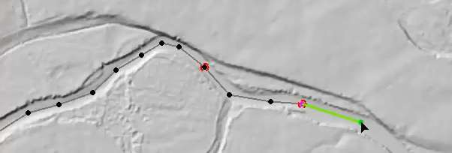
Add New Feature
Left-click to start adding a new point, line, or polygon
Double-click to end a line or polygon
Pan by switching to Pan tool, Shift key, Middle Mouse, or right-click to re-center.

Slide 31
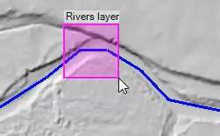
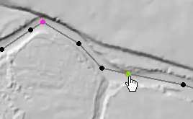
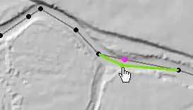
Select / Edit
Select / Edit tool is used to select feature(s) and then begin editing (move, add points, delete, etc).
Double-click to Start Editing (Open feature)
Double-click to End Editing (Close feature)
Mouse hover indicates action
Green point indicates: Move, Insert, Delete point

Slide 32
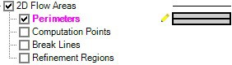
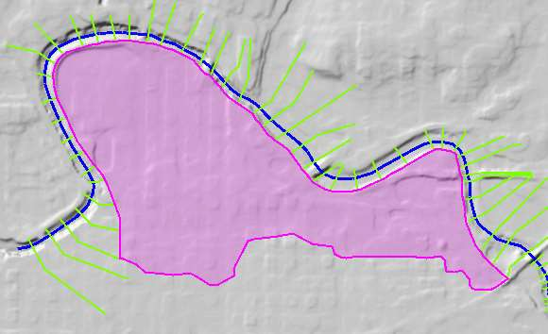
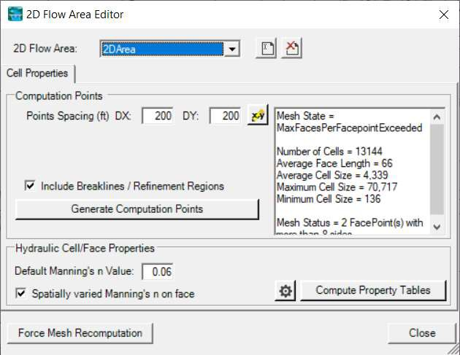
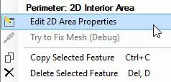
2D Flow Area
Draw Perimeter
2D Flow Area Editor
10

Slide 33
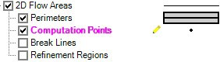
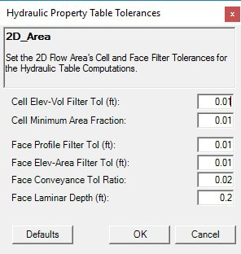
Computation Points
Generate Computation Points at an even interval
Breaklines and Refinement Regions area enforced
N Value (Default or Spatially Varied)
Hydraulic Table Property Tolerances

Slide 34
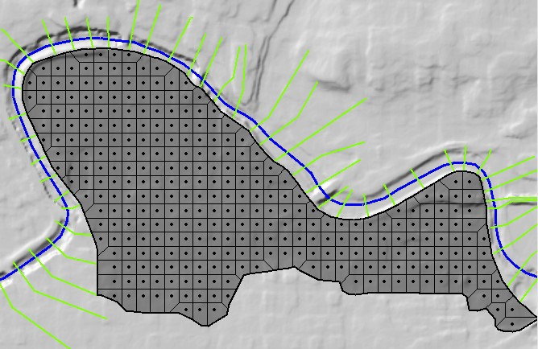
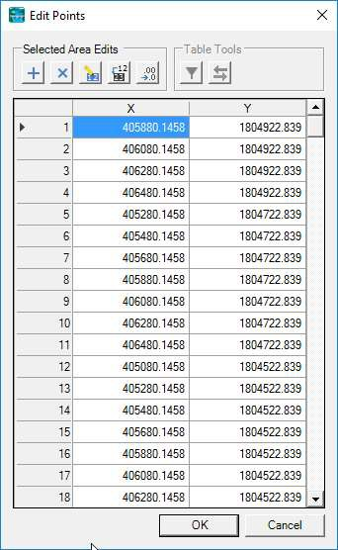
Computation Points
Mesh is generated from resultant set of computation points.

Slide 35
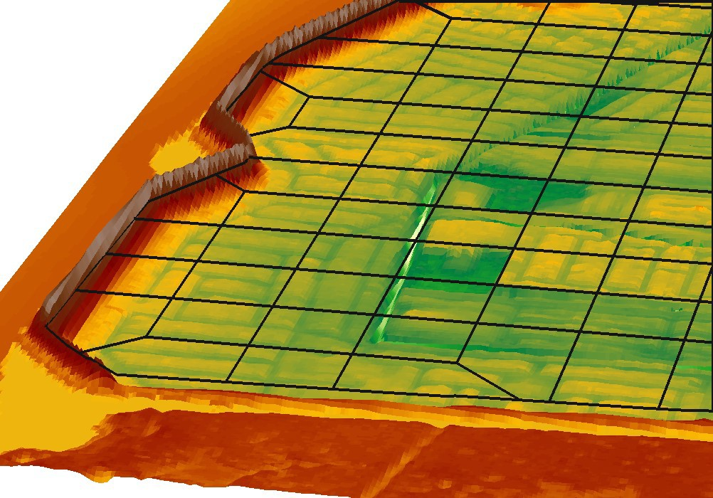
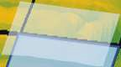

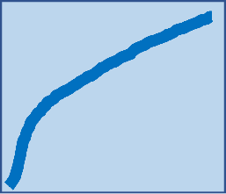
Hydraulic Property Tables and terrain information
Computation engine uses hydraulic property tables to represent the geometry of the system
Cells
Elevation/Volume
Faces
Elevation/Area
Elevation/Wetter Perimeter
Elevation/Manning’s n
(all from station elevation profile)
RAS2D Cell
Elevation (ft)
Cell Face
Station (ft)
Elevation (ft)
Elevation (ft)
Station (ft)
Volume (ft3)
Each cell face profile and stage-volume curve is based on hundreds to thousands topo-bathymetric data-points, depending of resolution of underlying terrain raster.
Cell approach very efficiently discretizes space including complex terrain & surface roughness.

Slide 36
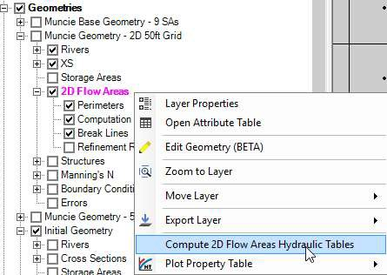
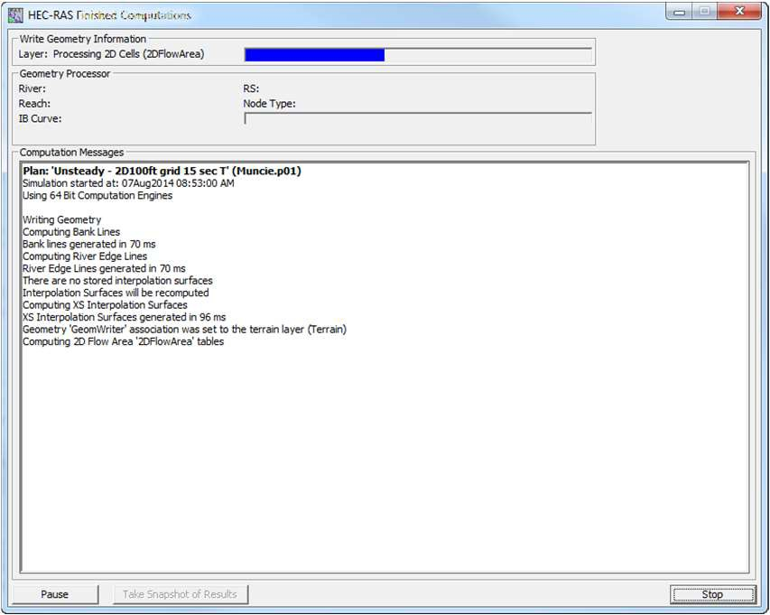
Hydraulic Property Tables and terrain information
Computed (once and stored in geometry *.hdf)
From RAS Mapper
Before unsteady-flow simulation
This MUST be done in order for hecras to work

Slide 37
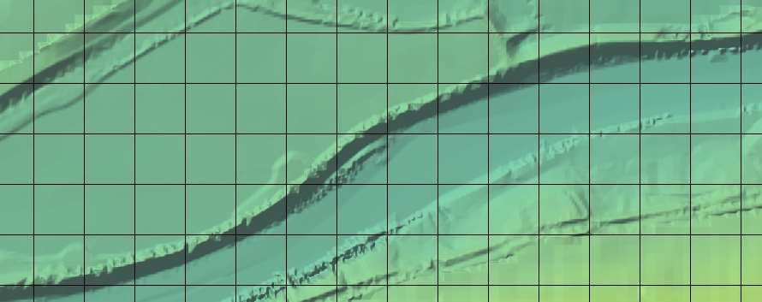
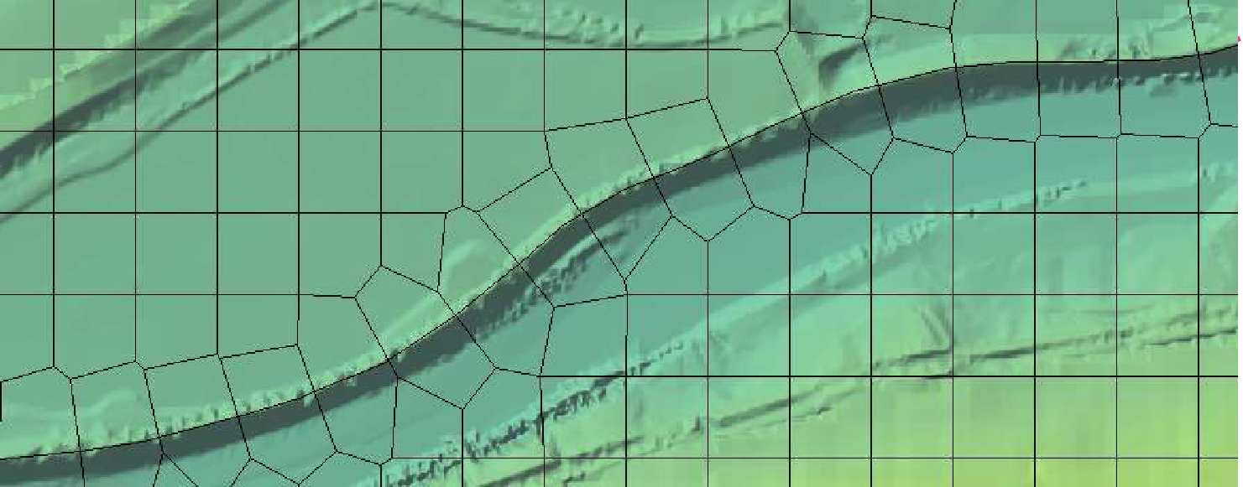
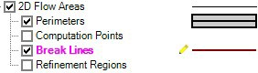
Mesh Limitations
One face between cells – even on perimeter
Only one boundary condition per Face
Except for Lateral structures
Lateral structures can stop and start on the same 2D external Face, when connecting 1D reach to a 2D area.
One can ‘help’ reducing these limits, by adding breaklines
Breaklines enforce Cell Faces inside of the Mesh.
Place along linear features that control water movement

Slide 38
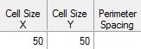
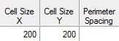




How is resolution controlled?
Grid spacing = 100
The mesh resolution impacts drastically the results. Finer meshes improve flow routing, but they increase the computational time

Slide 39
Computation Points
Final mesh is based on final computation point set.
Enforcement of Breaklines and Refinement Regions modifies existing computation points.
Can enforce a breakline once, change parameters and enforce again.
Each iteration modifies the previous points.
Point Regeneration will automatically use Breaklines
and Refinement Regions (if included).

Slide 40


Fixing Problems
If cell spacing is too large, cell faces may not be enforced

Slide 41



Fixing Problems
More than 8 sides on a cell.
Fix by Hand
Auto “Try Fix” menu option

Slide 42


Fixing Problems
Cells need to have exactly one Computation Point (Black Dot)
Fix graphically by adding more points and/or moving points near perimeter

Slide 43




Mesh Evaluation

Slide 44
Questions?
33

